Slide 1
Email Spam Detection
A Machine Learning Project using Logistic Regression

Slide 2
Goal/Objective
Classifying the incoming emails as spam or not spam.
Logistic Regression does a best job in classification as it gives good accuracy and is simple baseline model.

Slide 3
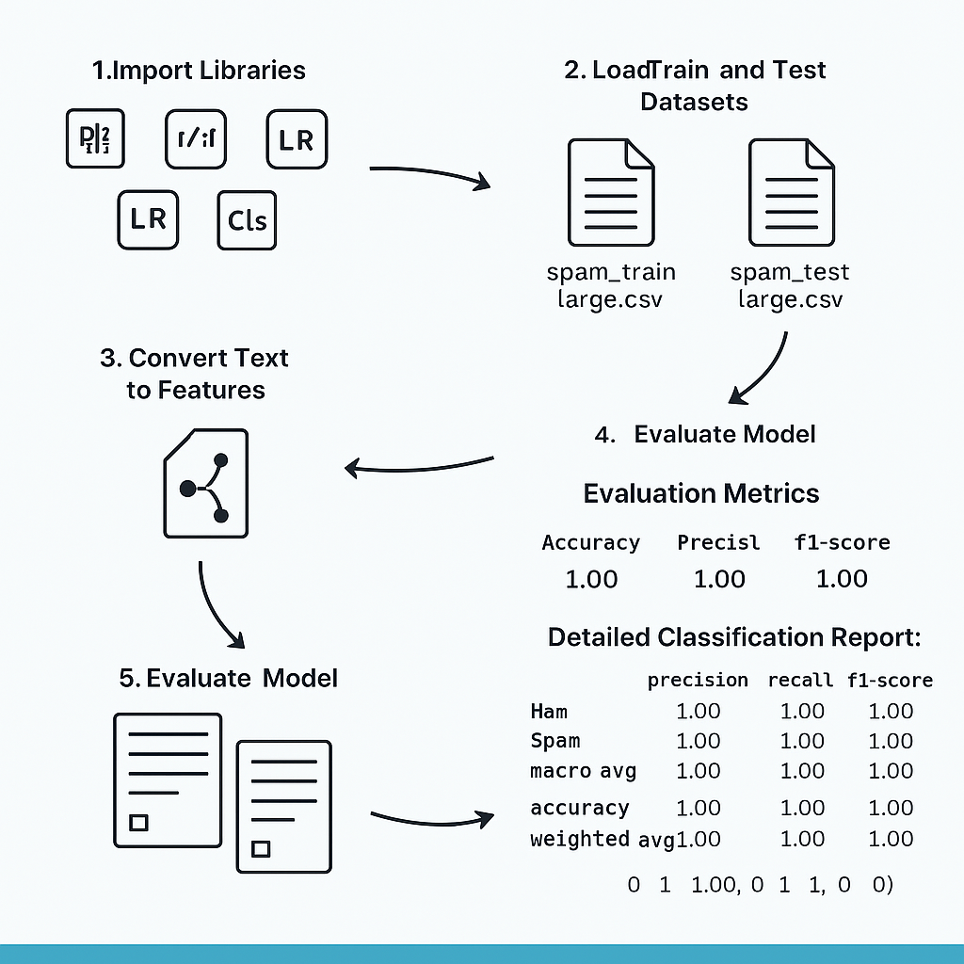
Process steps

Slide 4
Train-Test Split
Split the dataset into training and testing sets (80/20 split).
Ensured balanced data preprocessing for both sets.

Slide 5
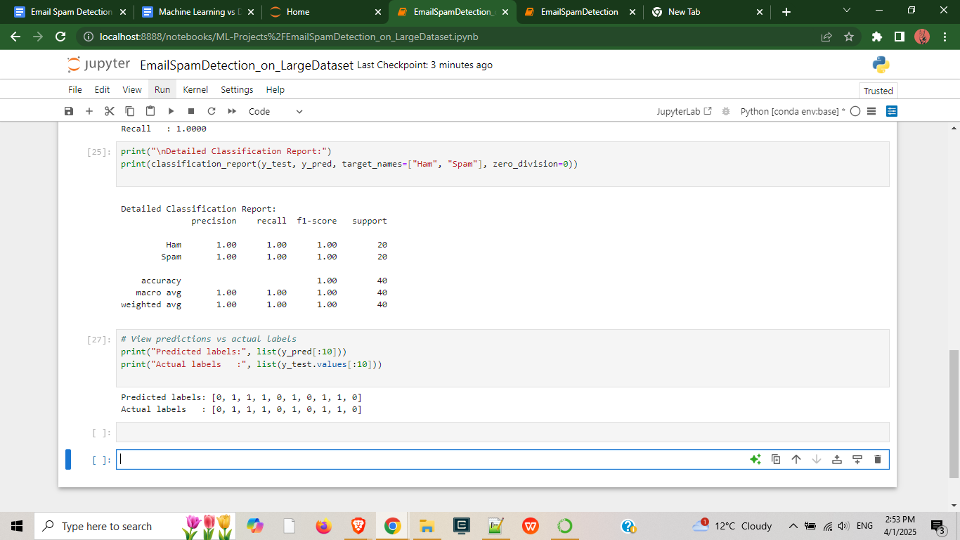

Slide 6
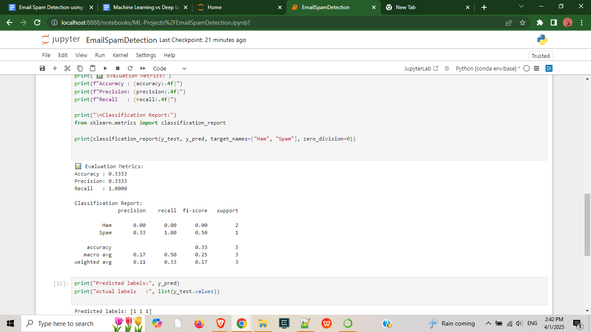

Slide 7
Result Interpretation
When using small dataset the model showed low accuracy and poor precision.
When using large dataset the model achieved perfect accuracy,precision and recall.

Slide 8
Value Proposition
A lightweight spam detection model demonstrates how it performs on minimal dataset.
A robust high accuracy spam detection system on Large dataset.

Slide 9
Tools/Resources Used
Jupyter Notebook
Python Libraries: pandas, scikit-learn, seaborn, matplotlib
UCI spam dataset

Slide 10
Thankyou

